Slide 1

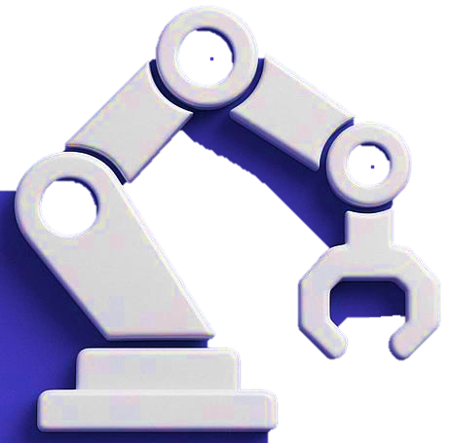
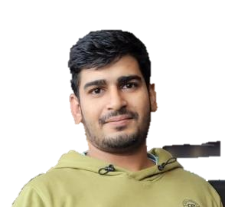


Optimotion
School of Technology & Computing
Sumit Chahar
Masters
of
Verónica Elze
Data Science
Artificial Intelligence
Notes:
"Hi everyone, and welcome to our final project presentation on Optimotion. We explored how a simulated robotic arm could learn to move more efficiently using pure math — no pre-trained models, just linear algebra, gradient descent, and a lot of plotting. I’m Verónica Elze, joined by Sumit Chahar, and we’re excited to share our journey."

Slide 2
Agenda
Problem & Background
Mathematical Approach
Methodology
Proof of Concept (PoC)
Minimum Viable Product (MVP) Improvements
Results & Lessons Learned
Future Potential
Notes:
"Here’s our roadmap: we’ll start with the problem, background, and mathematical approach. Then walk through our methodology, initial proof of concept, the improvements made from our PoC to MVP and finally wrap up with our results, Lessons Learned, and future potential. Let’s dive in."

Slide 3
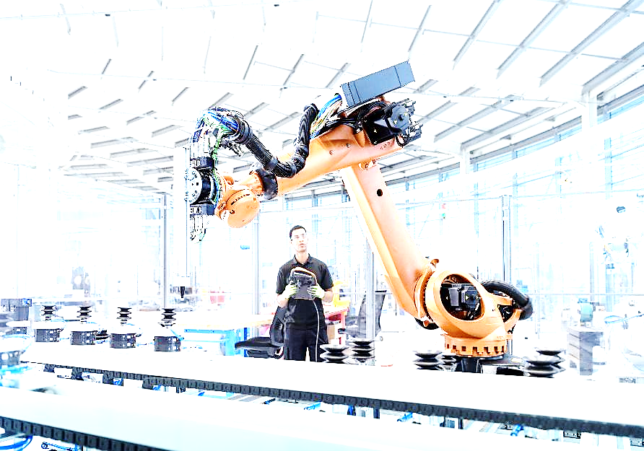
Problem Definition & Importance
How can we teach a simulated robotic arm to reach a target point efficiently?
Real-world relevance: industrial robots, surgical robotics, assistive tech
Key challenge: precision with minimal movement and energy
Notes:
"The challenge? Teach a robotic arm to reach a target point in 2D space as efficiently as possible. This might sound simple, but it mimics real-world problems in manufacturing, surgery, and assistive tech where precision, smoothness, and efficiency matter a lot.“

Slide 4
Background & Research

Slide 5
Background & Related Work
Topics Explored:
Robot kinematics (Craig, 2005)
Optimization and Control Systems
Energy-aware trajectory planning
Supervised Learning as an alternative path
Notes:
"We explored academic and industry research on kinematics, optimization, and control strategies. From Denavit-Hartenberg modeling to energy-efficient planning and reinforcement learning, we wanted our approach to reflect both classical mechanics and modern trends in robotics."

Slide 6
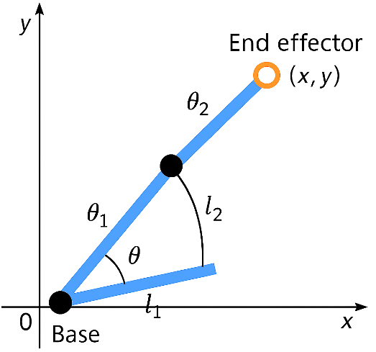
Mathematical Foundations
Forward Kinematics (angle → position)
Cost Function (distance from goal)
Gradient Descent (iterative optimization)
Penalty terms for smoother movement
Notes:
"At its core, Optimotion is a math problem. We used forward kinematics to calculate positions, gradients to guide improvement, and a Euclidean cost function to define success. It’s a hands-on application of what we covered in DS623 — but with a robot arm instead of a formula sheet."

Slide 7
Key Terms & Concepts
Forward Kinematics: maps θ₁, θ₂ → (x, y)
Cost Function: √[(x_target - x_end)² + (y_target - y_end)²]
Gradients: calculated using finite difference approximation
Optimization goal: minimize cost function
Notes:
"Some quick definitions: Forward kinematics determines where the arm ends up based on its angles. Our cost function measures how far we are from the goal. And gradient descent is how we inch closer — mathematically — one small correction at a time.“

Slide 8
Methodology & Proof of Concept

Slide 9
Methodology Overview
Built from scratch using NumPy and Matplotlib
All logic coded manually (no auto-grad)
Tracked cost and pose updates over 50 iterations
Saved visualizations and data for reproducibility
Notes:
"We built a simulation from scratch using NumPy and Matplotlib. Our PoC used numerical gradients to adjust joint angles and minimize distance to the target. Everything — from cost calculation to plotting — was coded manually to stay grounded in core math."

Slide 10
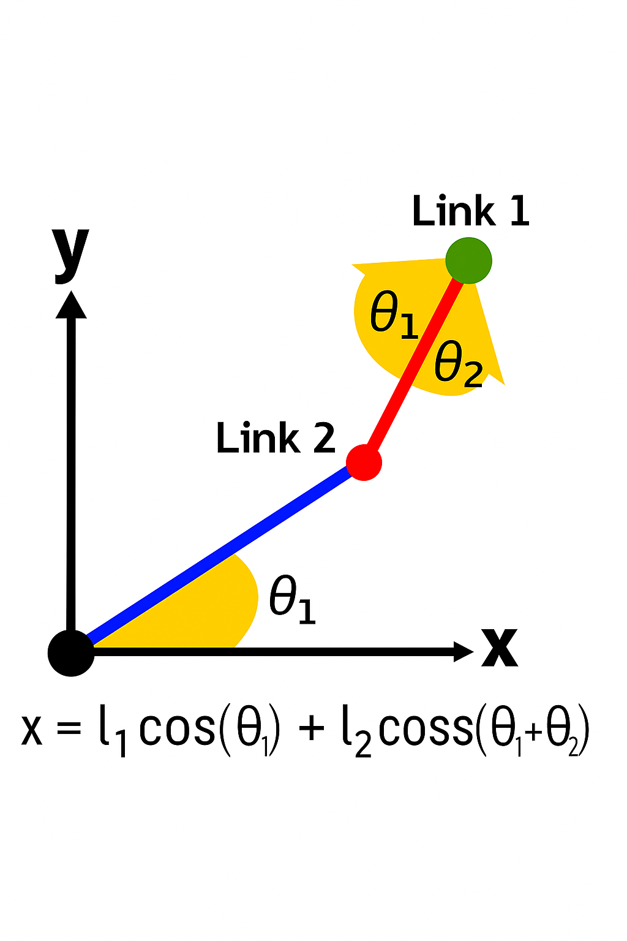
Forward Kinematics
Position calculated via:
x = l1*cos(θ₁) + l2*cos(θ₁ + θ₂)
y = l1*sin(θ₁) + l2*sin(θ₁ + θ₂)
Plots confirm pose based on angle inputs
Notes:
"This is our arm in motion. Using trigonometry, we calculated the end-effector’s position from two joint angles. This let us visualize how the arm configuration changes — and more importantly — how close we’re getting to the goal."

Slide 11
Cost Function & Optimization
Cost = Euclidean distance + optional λ penalty
Used numerical gradients (finite difference)
Gradient descent adjusts θ₁ and θ₂ to reduce cost
Ran for 50 iterations with fixed learning rate
Notes:
"Here you see our cost function in action: a basic Euclidean distance with an optional penalty for joint effort. Gradients were calculated numerically using finite difference — we slightly bumped each angle to estimate how much the cost would change."

Slide 12
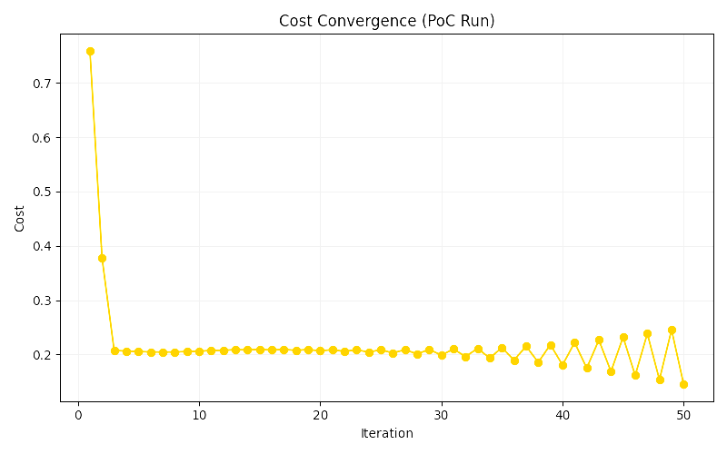
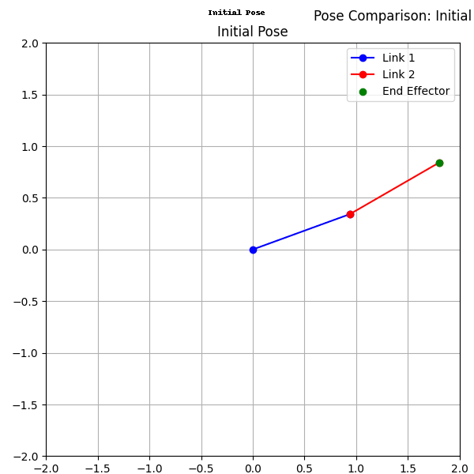
Optimization Results (PoC)
Confirmed viability of optimization approach
0.759 → Final Cost: 0.145
Notes:
"Here’s what it looks like when it works: The animation switches between original and optimized pose. The cost drops from 0.759 to 0.145 over 50 iterations — a good sign that our algorithm was moving in the right direction."

Slide 13
Minimum Viable Product (MVP) Enhancements
Notes:
“Next, we’ll hear from Sumit on how he enhanced our Proof-of-Concept work to turn it into a Minimum Viable Product (MVP).”

Slide 14
Expanding Optimization
Scaled up to optimize 1,000 target positions
Evaluated performance across a grid
Revealed weaknesses in fixed learning setup
Created foundation for further model refinement
Notes:
~Sumit
"TP03 leveled up our PoC by scaling the optimization across 1,000 target positions. This multi-target simulation let us evaluate how robust our approach was — not just in one lucky case, but across an entire grid."

Slide 15
Optimization Upgrades
Added learning rate decay
Explored λ values: 0.01, 0.1, 1.0
Implemented convergence threshold
Penalty on angle change between iterations (optional)
Notes:
~Sumit
"To improve performance, we added adaptive learning rate decay and penalty terms. The decay helps fine-tune near the minimum, and the penalties prevent the arm from flailing into extreme, inefficient positions. The math: smarter and safer."

Slide 16
Stretch Goal: Supervised Learning
Trained regression model on optimized (θ₁, θ₂) from grid
Input: (x, y), Output: predicted joint angles
Bypass gradient descent at inference time
Demonstrates alternate control path
Notes:
~Sumit
"We also added a convergence threshold to stop the algorithm once improvement slowed. This made the optimization more efficient and kept us from wasting cycles once we were close enough to optimal."

Slide 17
Comparative Results
Cost heatmap: effectiveness of combined strategies
Best performance: λ = 0.1 + learning rate decay
Convergence: faster and smoother than TP02
Notes:
~Sumit
"For our stretch goal, Sumit explored a supervised approach. Instead of optimizing on the fly, we trained a regression model to predict joint angles from target coordinates — essentially skipping the optimization step with a smart guess."

Slide 18
Lessons Learned
Gradient descent: effective but sensitive to tuning
Modeling optimization: manually deepened understanding
Visualization: helped validate intuition
Notes:
~Sumit
"Here’s where it all comes together: A heatmap showing cost performance for each combination of optimization techniques. The best results came when we combined learning rate decay, energy penalty, and smoothness. In other words — optimization of the optimizer."

Slide 19
Future Work
Scale to 3-joint arms
Explore neural nets vs regression
Compare performance on curved target paths
Deploy to a physics-based simulator like MuJoCo
Notes:
~Sumit
"We learned that even simple models become powerful when guided by thoughtful optimization. Gradient descent works, but tuning it — decay, penalties, thresholds — is what takes it from good to great. And math, when visualized, is surprisingly intuitive.“
"To improve accuracy, especially for more complex joint behavior like theta₂, we’d explore non-linear models like decision trees or neural nets. We’d also scale to 3+ joint arms and explore physical-world simulation platforms like MuJoCo or ROS."

Slide 20
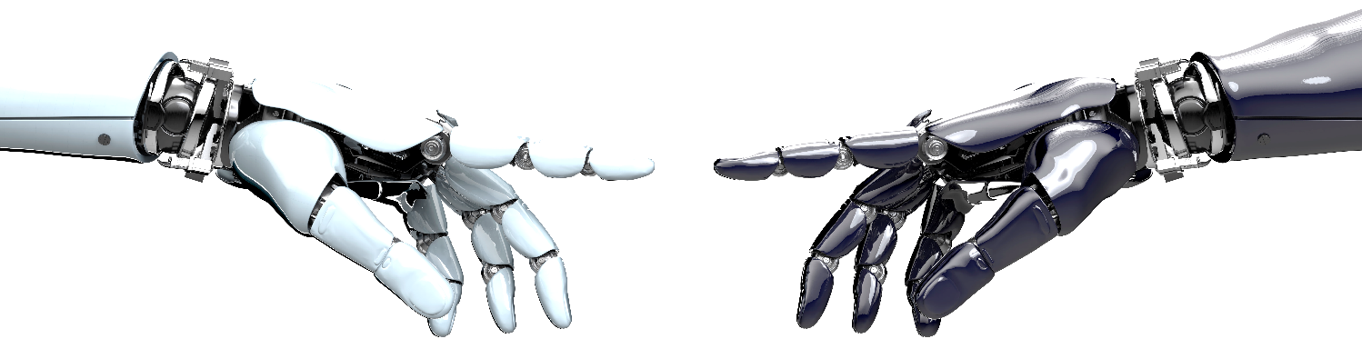

Thank you!
Sumit Chahar
MS of DS
Verónica Elze
MS of AI
Notes:
~Sumit
"Thanks for your time! Verónica and I would love to hear your questions via email — whether it’s about the math, the simulation, or how this could evolve in real-world robotics."

Slide 21
Key References
Craig (2005), Carabin & Scalera (2020), Sumit TP03, Verónica TP02
OpenAI Gym, Matplotlib, NumPy, D4RL, DeepMind Control Suite
Notes:
~Sumit
"All of our sources, tools, and libraries are briefly referenced here — including foundational kinematics, control theory, and simulation environments."

